Slide 1



SUSTAINABLE SUPPLY CHAIN PERFORMANCE DASHBOARD IN POWER BI

Slide 2

Learning Objectives
Gained hands-on experience in Power BI dashboard creation by building an interactive dashboard to track supply chain sustainability metrics effectively.
Improved data analysis and visualization skills by transforming raw data into meaningful insights using Power BI’s advanced features.
Understood key supply chain performance metrics by analyzing sustainability indicators like CO₂ emissions, delivery efficiency, and inventory levels.
GOAL
Source :
www.freepik.com/

Slide 3
Tools and Technology used
Utilized Power BI for creating an interactive and insightful dashboard.
Imported and processed a CSV dataset, splitting it into multiple tables for better accessibility and understanding.
Designed and styled visualizations using Power BI’s visualization tools to enhance data interpretation.
Analyzed key supply chain performance metrics using structured tables and dashboards.
Used Git/GitHub for version control and uploading weekly assignments.

Slide 4
Methodology
1. Data Collection & Import
Gathered a CSV dataset containing supply chain performance metrics.
Loaded the dataset into Power BI, splitting it into multiple tables for better organization.
Data Preprocessing & Transformation
Cleaned and structured data using Power Query.
Data Modeling & Relationships
Established relationships between multiple tables for better accessibility and performance.
Dashboard Development & Visualization
Created interactive visualizations (bar charts, KPIs, line graphs, etc.) to analyze key metrics.
Styled and structured the dashboard for clear insights and better readability.

Slide 5
Problem Statement:
Businesses face challenges in monitoring supply chain efficiency due to fragmented data and lack of real-time insights. Key metrics like inventory levels, delivery performance, and environmental impact are often difficult to analyze, leading to inefficiencies and increased costs. This project aims to solve these issues by developing a Sustainable Supply Chain Performance Dashboard in Power BI, which organizes large datasets, visualizes key performance indicators, and enables data-driven decision-making to enhance supply chain efficiency and sustainability.

Slide 6
Solution:
Developed a Sustainable Supply Chain Performance Dashboard using Power BI to analyze key metrics.
Structured large datasets into multiple tables for better accessibility and efficient data processing.
Utilized Power BI visualization tools to track inventory levels, delivery performance, and sustainability metrics.
Applied data modeling and DAX calculations to generate real-time insights and optimize decision-making.
Improved supply chain efficiency by identifying inefficiencies and enhancing resource utilization.
Enabled businesses to reduce costs, optimize operations, and drive sustainable practices.

Slide 7
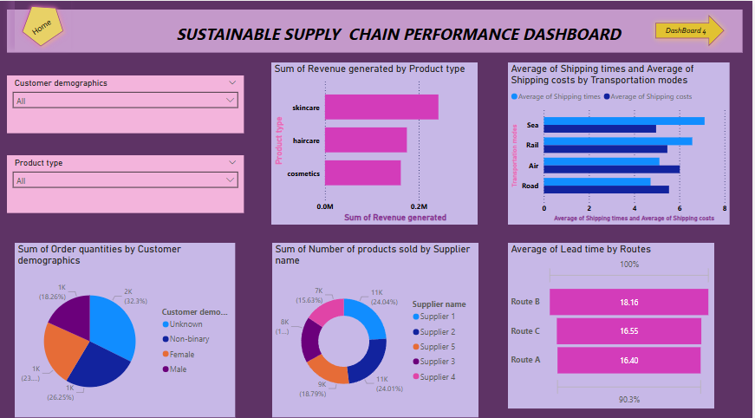
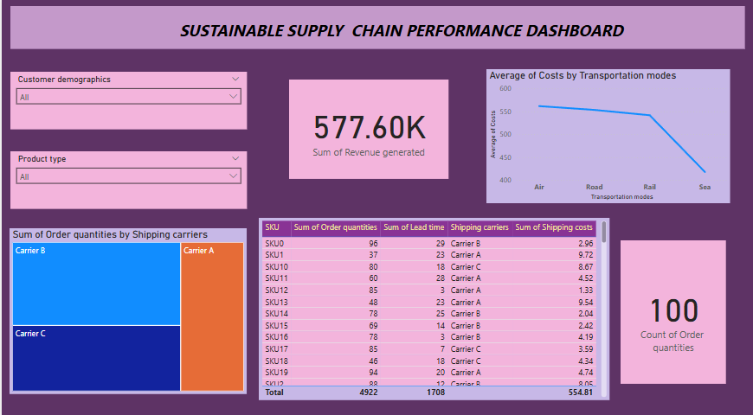
Screenshot of Output:

Slide 8
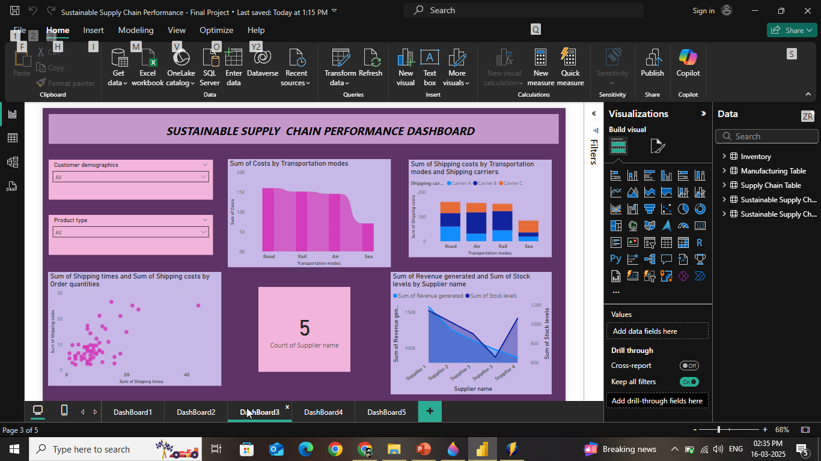
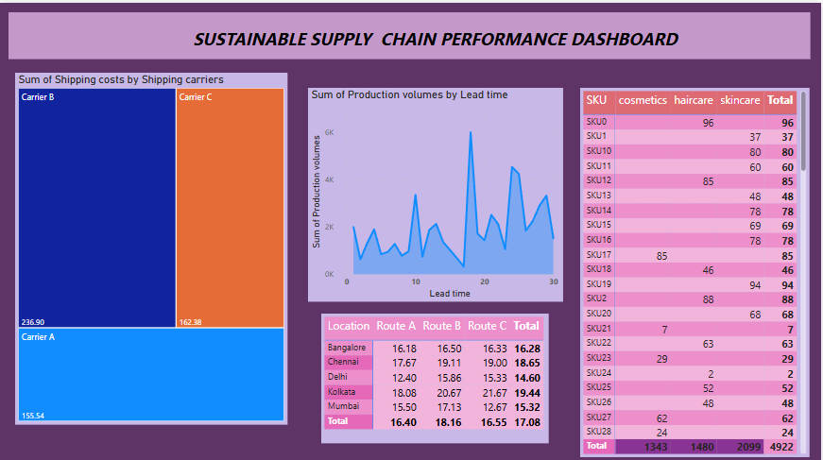
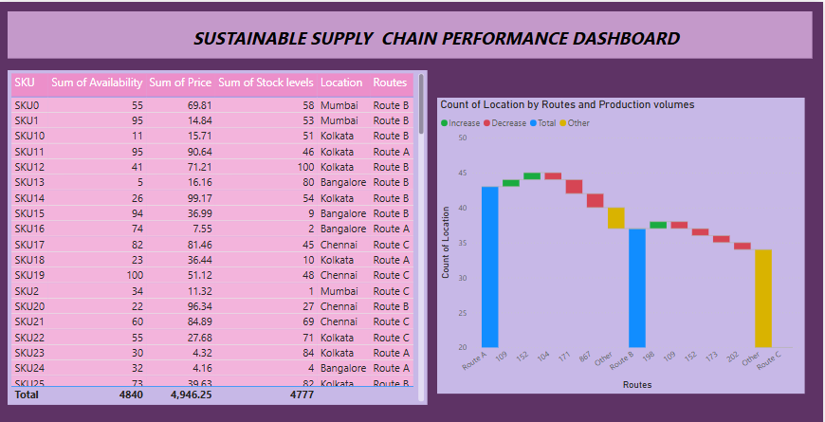
Screenshot of Output:

Slide 9
The Sustainable Supply Chain Performance Dashboard in Power BI enhances supply chain efficiency by providing real-time insights into key metrics like inventory, delivery performance, and sustainability. By structuring large datasets and using interactive visualizations, businesses can make data-driven decisions to reduce costs, optimize operations, and improve resource utilization. This project not only streamlines supply chain management but also promotes sustainable practices for long-term success.
Conclusion:

Slide 10
THANK YOU

